Slide 1
Computer Modelling and Simulation
Lecture 1

Slide 2
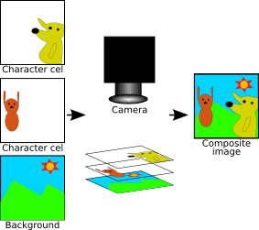
Simulation?
https://www.youtube.com/watch?v=0kHOYavm7VY
https://youtu.be/aQkJM13PMKw?t=75
https://www.youtube.com/watch?v=sQR1H9XKmzU
https://www.youtube.com/watch?v=kza8gW_jnl8
https://www.youtube.com/watch?v=tQvwiOWpj7o
Traditional Animation

Slide 3
Simulation?
https://www.youtube.com/watch?v=eUDoGnTObms&t=279s
https://www.youtube.com/watch?v=R3O66YZTiEM

Slide 4
Simulation?
https://www.youtube.com/watch?v=JpV-avDIBbY&list=PLSNs3oxgiyKSfiFrxr9_oE1vlo0-EopJV&index=6
https://www.youtube.com/watch?v=YeYW8TIWLG8

Slide 5
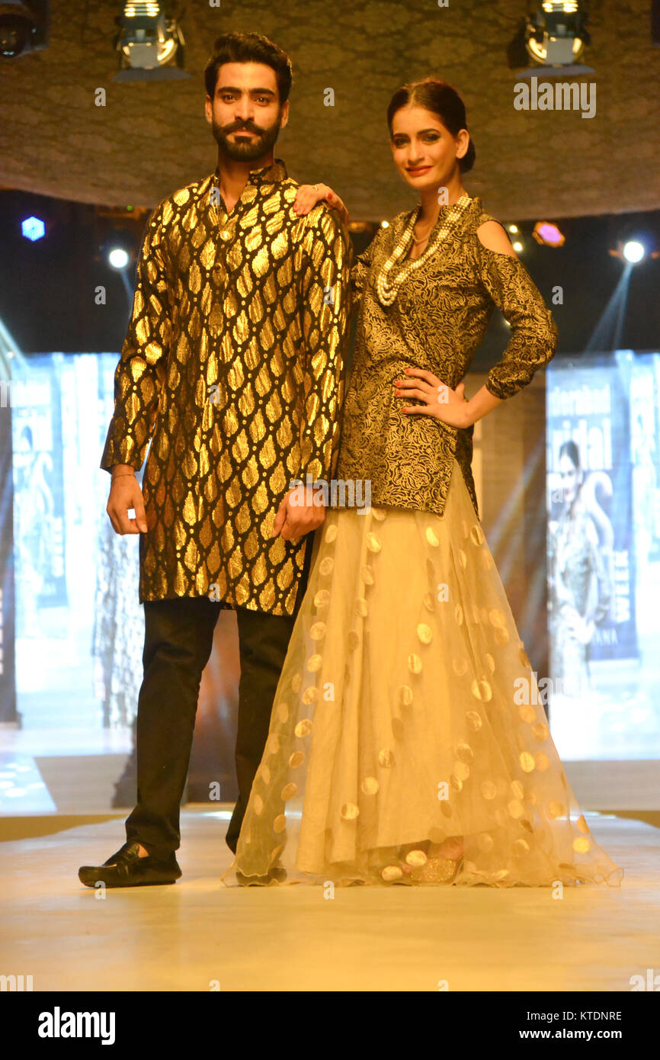
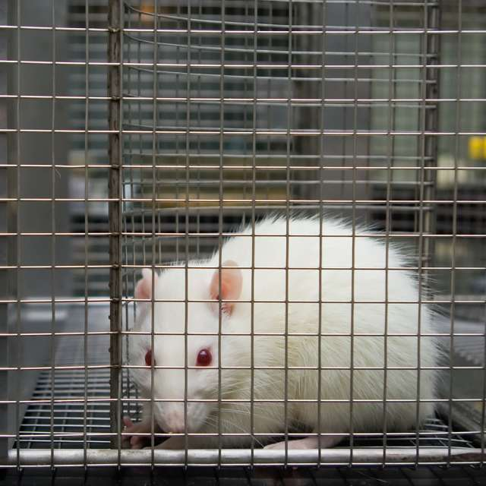
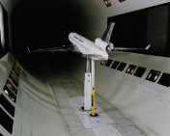
Model?

Slide 6
Mathematical Model of a free falling body
Consider a model that represents the vertical height of an object moving in one dimension under the influence of gravity.
The mathematical model takes the form of an equation
h = 1/2 at² + vt + s
where
h = height (feet),
t = time in motion (seconds),
v = initial velocity (feet per second, + is up),
s = initial height (feet),
a = acceleration (feet per second per second).

Slide 7
Simulation of a free falling body
Simulation Example 1
/* Height of an object moving under gravity. */
/* Initial height v and velocity s constants. */
main()
{
float h, v = 100.0, s = 1000.0;
int t;
for (t = 0, h = s; h >= 0.0; t++)
{
h = ( -16.0 * t * t) + (v * t) + s;
printf(“Height at time %d = %f\n ”, t, h);
}
}

Slide 8
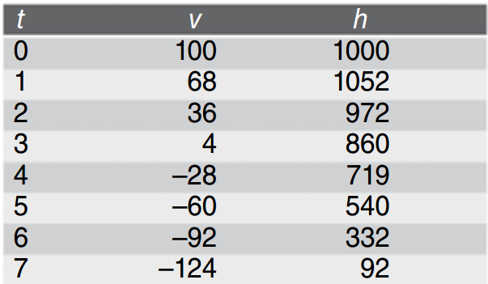
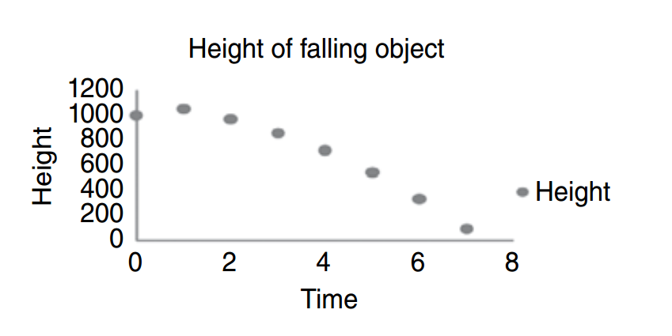
Simulation of a free falling body

Slide 9
Simulation
Multiple definitions:
A nontechnical meaning not real, imitation
A method for implementing a model over time.
A technique for testing, analysis, or training in which real - world systems are used
An unobtrusive scientific method of inquiry involving experiments with a
model rather than with the portion of reality that the model represents
A methodology for extracting information from a model by observing the
behavior of the model as it is executed

Slide 10
Introduction to Modelling and Simulation
Modeling and Simulation (M&S) is a separate discipline with it’s own body of knowledge, theory and research methodology.
M&S is founded on the following concepts:
Modeling: Models are approximations for the real - world .
Simulation: Repeated observation of the model.
Analysis: Aids in the ability to draw conclusions and make recommendations based on various iterations or simulations of the model.
Visualization: The ability to represent data as a way to interface with the model
Verification and Validation

Slide 11
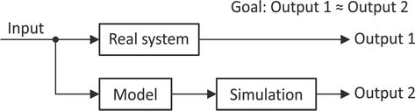
Modelling and Simulation
Modelling and simulation (M&S) is the use of models as a basis for simulations to develop data utilized for managerial or technical decision making.

Slide 12
What you’ll be able to do after this course?
Make simulations of different types of systems used in real world with the help of a simulation software i.e. NetLogo.
Create mathematical and graphical models of natural phenomena like population growth, predator-prey relationships, drug-dosage model, fall under gravity, spread of SARS etc
Study numerical solutions for the mathematical models of the systems
Study different types of modeling techniques (like Petri Nets, Cellular Automata etc) to represent systems.
Understand the role of randomness in real-world systems and model that randomness.

Slide 13
Mathematical Model of different systems
Predator Prey Relationship
ds/dt = k_{s}*s – k_{hs*}h*s
dh/dt = k_{sh}*s*h – k_{h} * h
Drug dosage Model
elimination = elimination_constant * aspirin_in_plasma
plasma_concentration = aspirin_in_plasma/plasma_volume

Slide 14
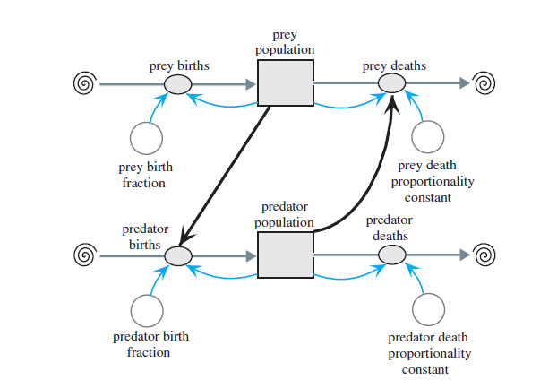
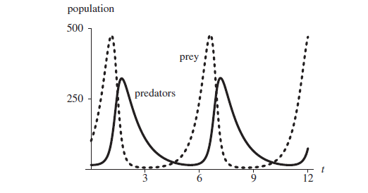
Graphical Representation of Predator-Prey Relationship and It’s analysis

Slide 15
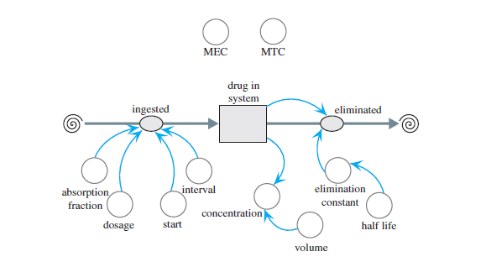
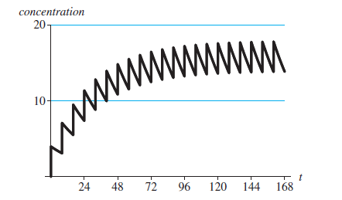
Graphical Representation of Drug Dosage Model and It’s analysis

Slide 16
Applications of M & S
Training — goal is to provide real - world experience/opportunities in a controlled environment e.g. flight simulator
Decision Support — to provide a descriptive, explanatory, predictive tool
Understanding — this type of modeling and simulation facilitates testing a hypothesis relative to the structure and function of a complex system e.g. modeling spread of covid or other infectious diseases
Education and Learning — used for teaching and learning systems with dynamic behavior and with serious gaming (this is also called game – based learning) e.g SuperBetter (a motivational game), FoldIt (puzzle solving game for the benefit of scientific research)
Entertainment — simulation provides a realistic representation for elements possessing dynamic behavior e.g. modern video games

Slide 17
Domains
Transportation M & S
Business M & S
Medical M & S
Social Science M & S

Slide 18
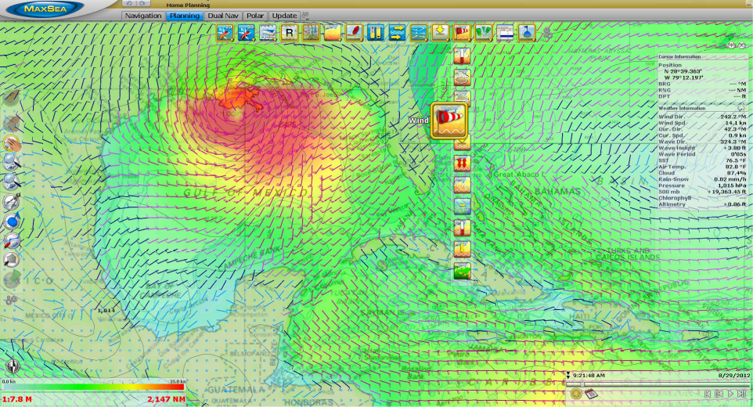
Applications of M & S
Weather Forecasting

Slide 19
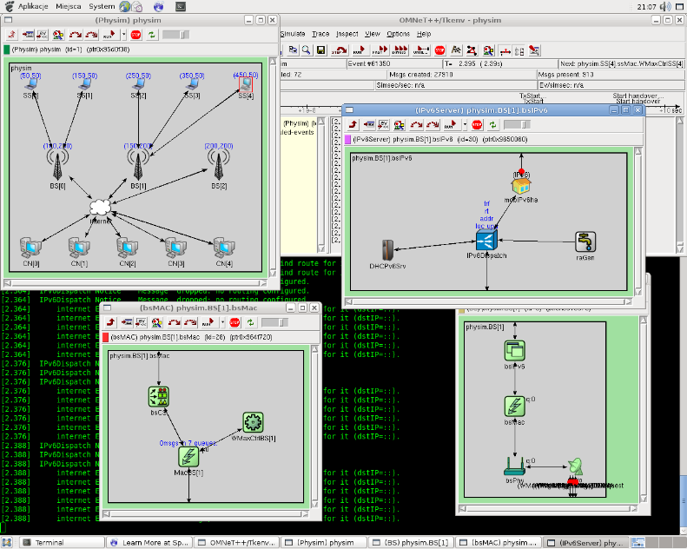
Applications of M & S
Examples of Network Simulations in Omnet++ (IMG: omnetplusplus.blogspot.com)

Slide 20
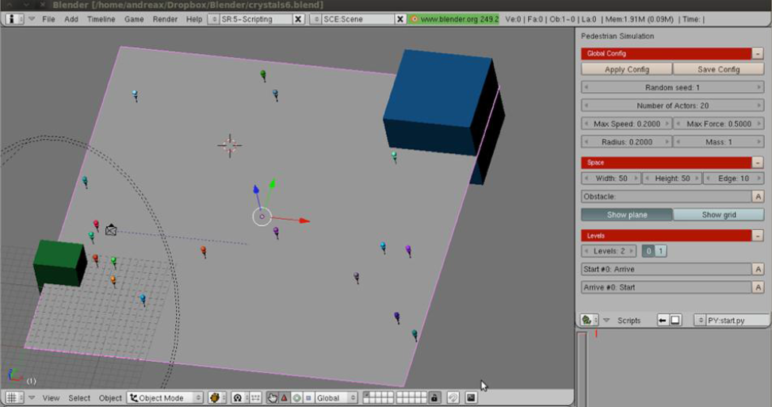
Applications of M & S
Crowd Modelling during Tawaf IMG: L. Manenti et. al., MAKKSim: Dealing with Pedestrian Groups in MAS-based Crowd Simulation

Slide 21
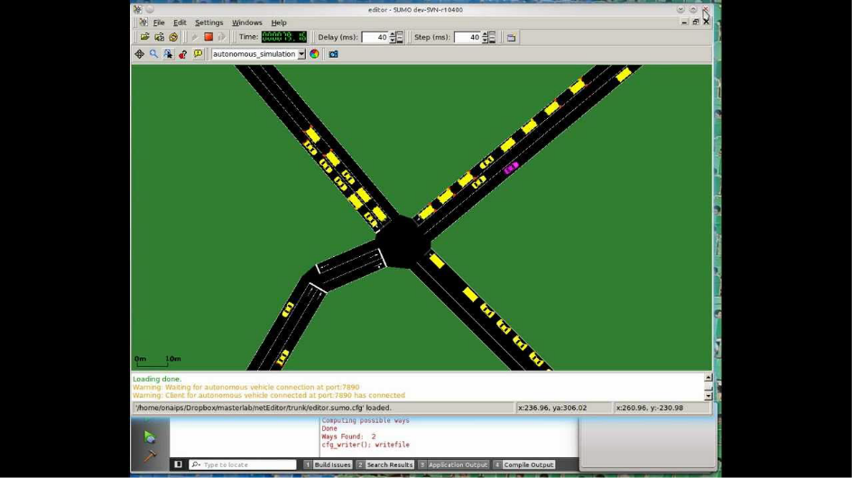
Applications of M & S
Simulation of Urban Mobility (SUMO)

Slide 22
How learning M&S will help you?
Job opportunities
https://www.glassdoor.com/Job/simulation-and-modeling-jobs-SRCH_KO0,23.htm
https://www.ziprecruiter.com/Jobs/Modeling-and-Simulation-Analyst

Slide 23
Pre-Requisites
Knowledge of Basic Mathematics
Knowledge of Programming Language
Willingness to work on many assignments and class activities

Slide 24
Course Policies
Attendance (strict 80% attendance - no compromise on attendance)
Zero Tolerance Policy for Plagiarism in assignments -(again no compromise)
Grading Policy:
Relative

Slide 25
Evaluations in the course
Quizzes - 5%-10%
Assignments - 15%
Sessionals (1&2) - 30% each
Final Exam - 45%-50%

Slide 26
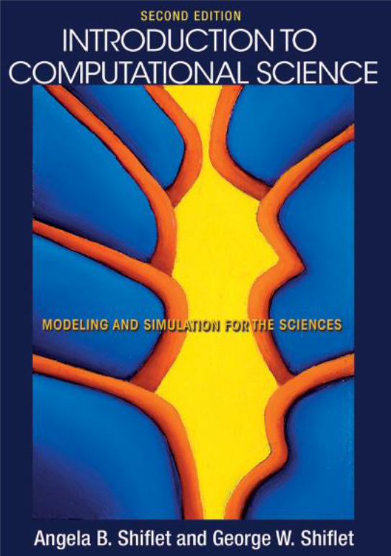
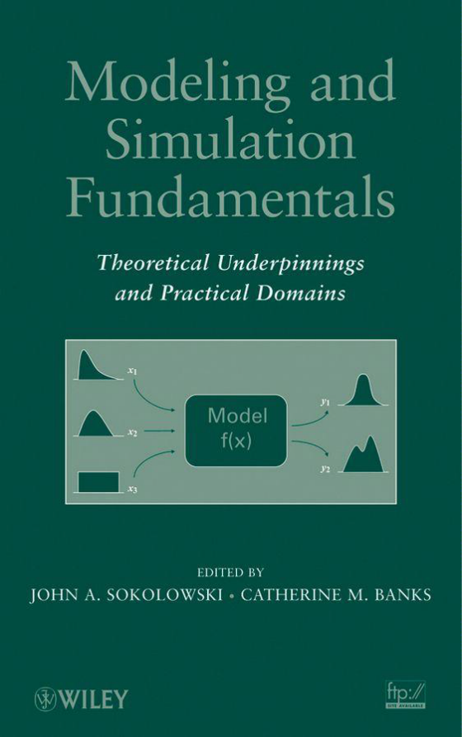
Recommended Books

